Slide 1
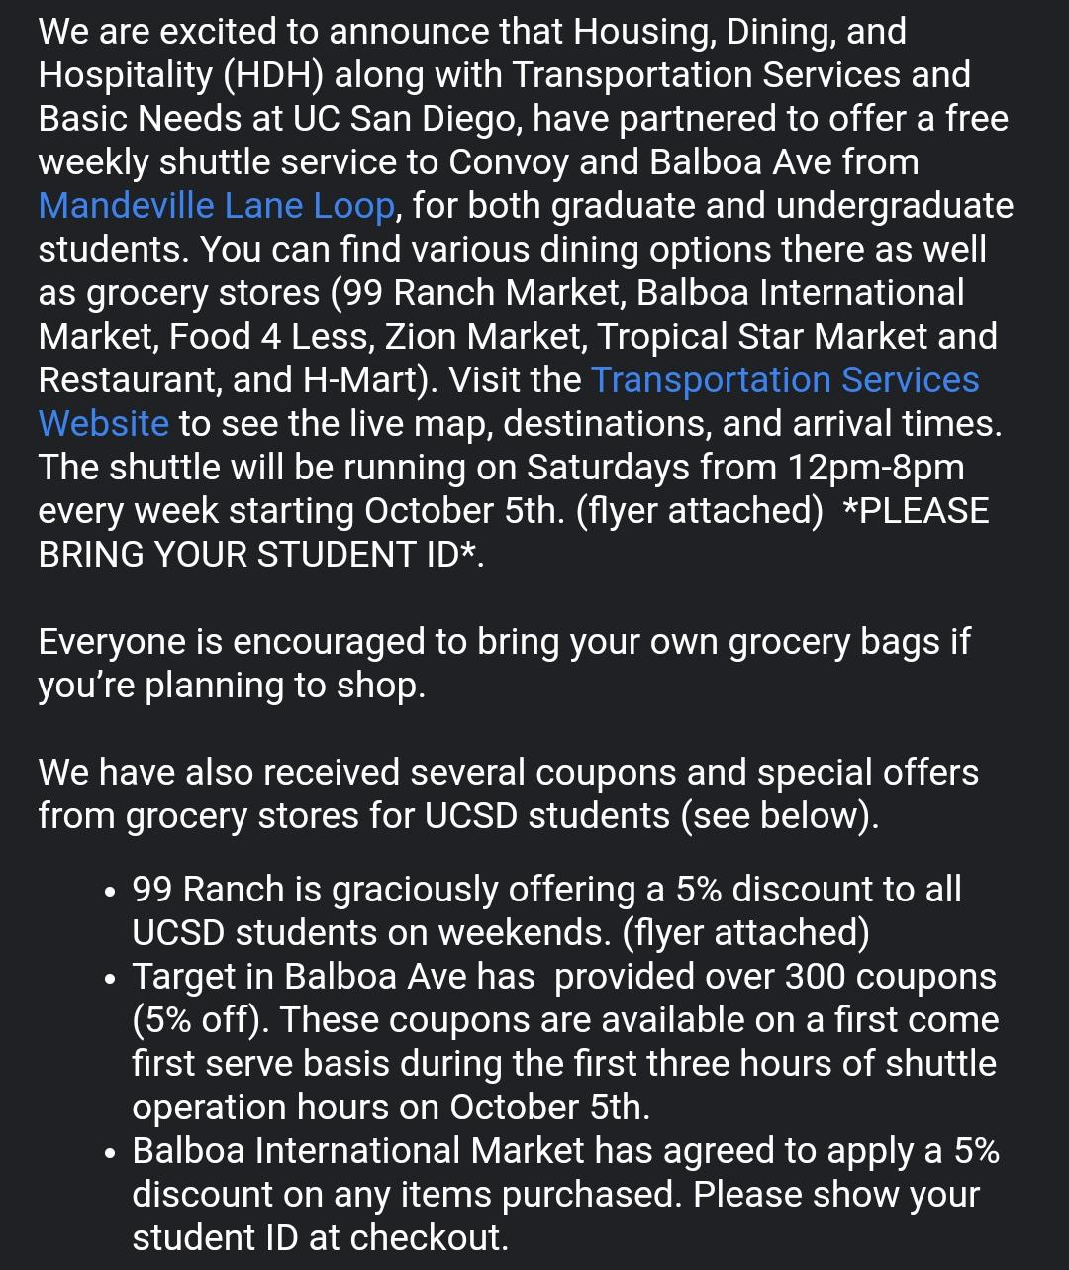
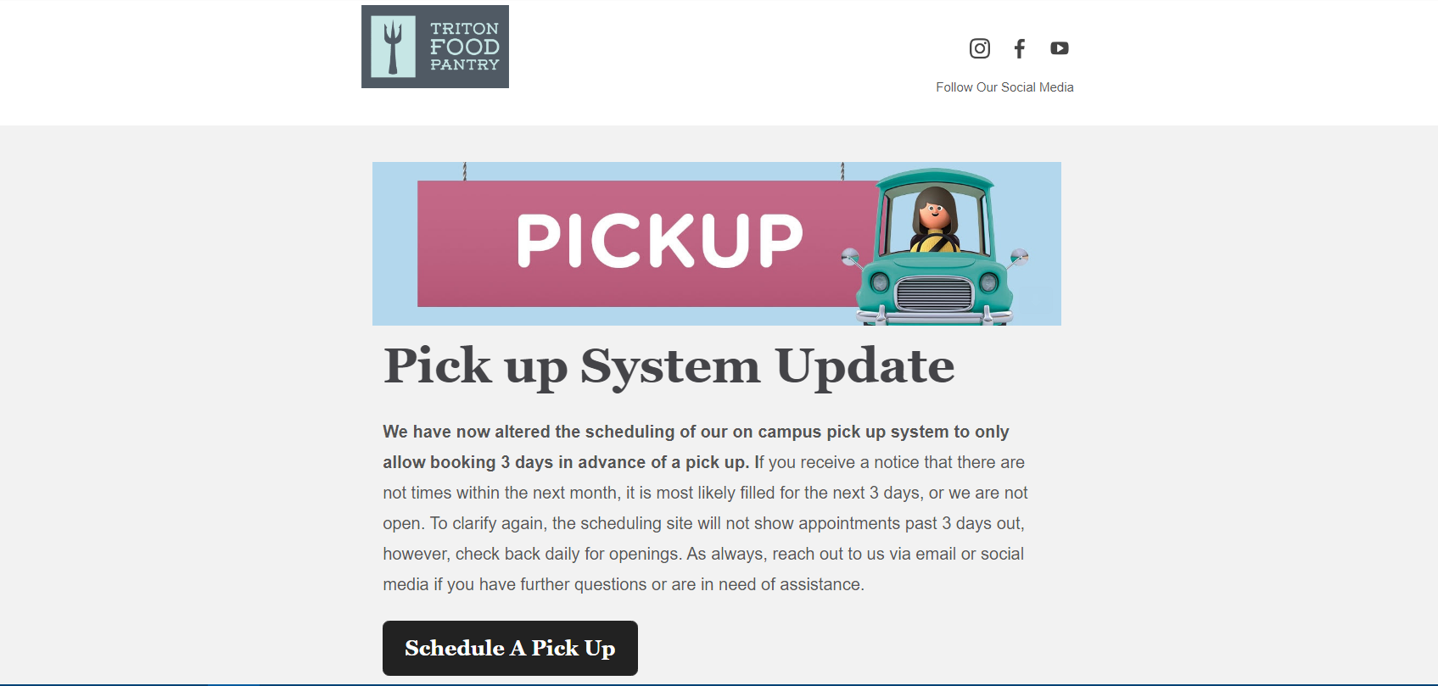
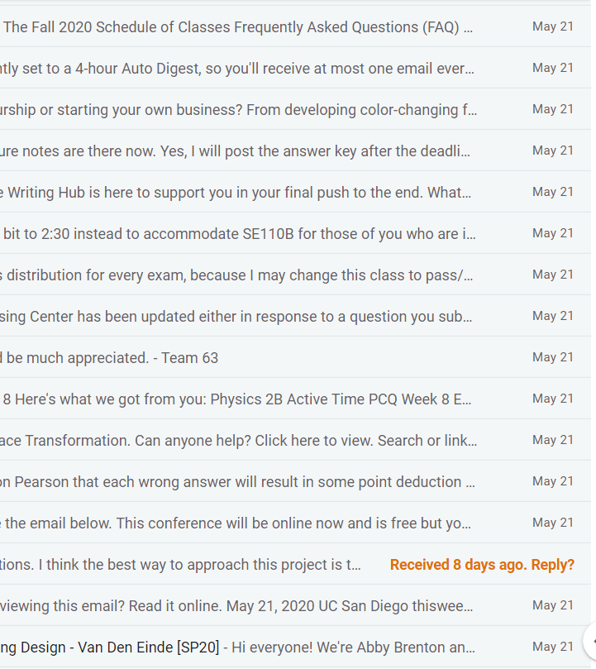
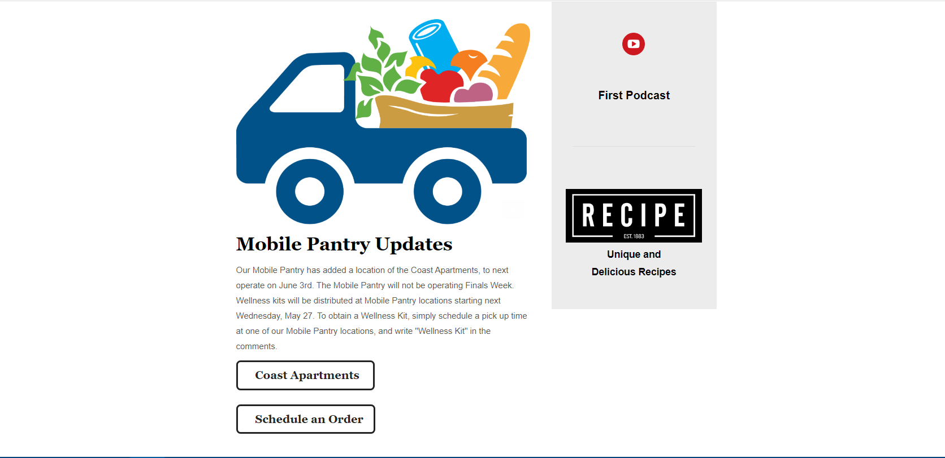
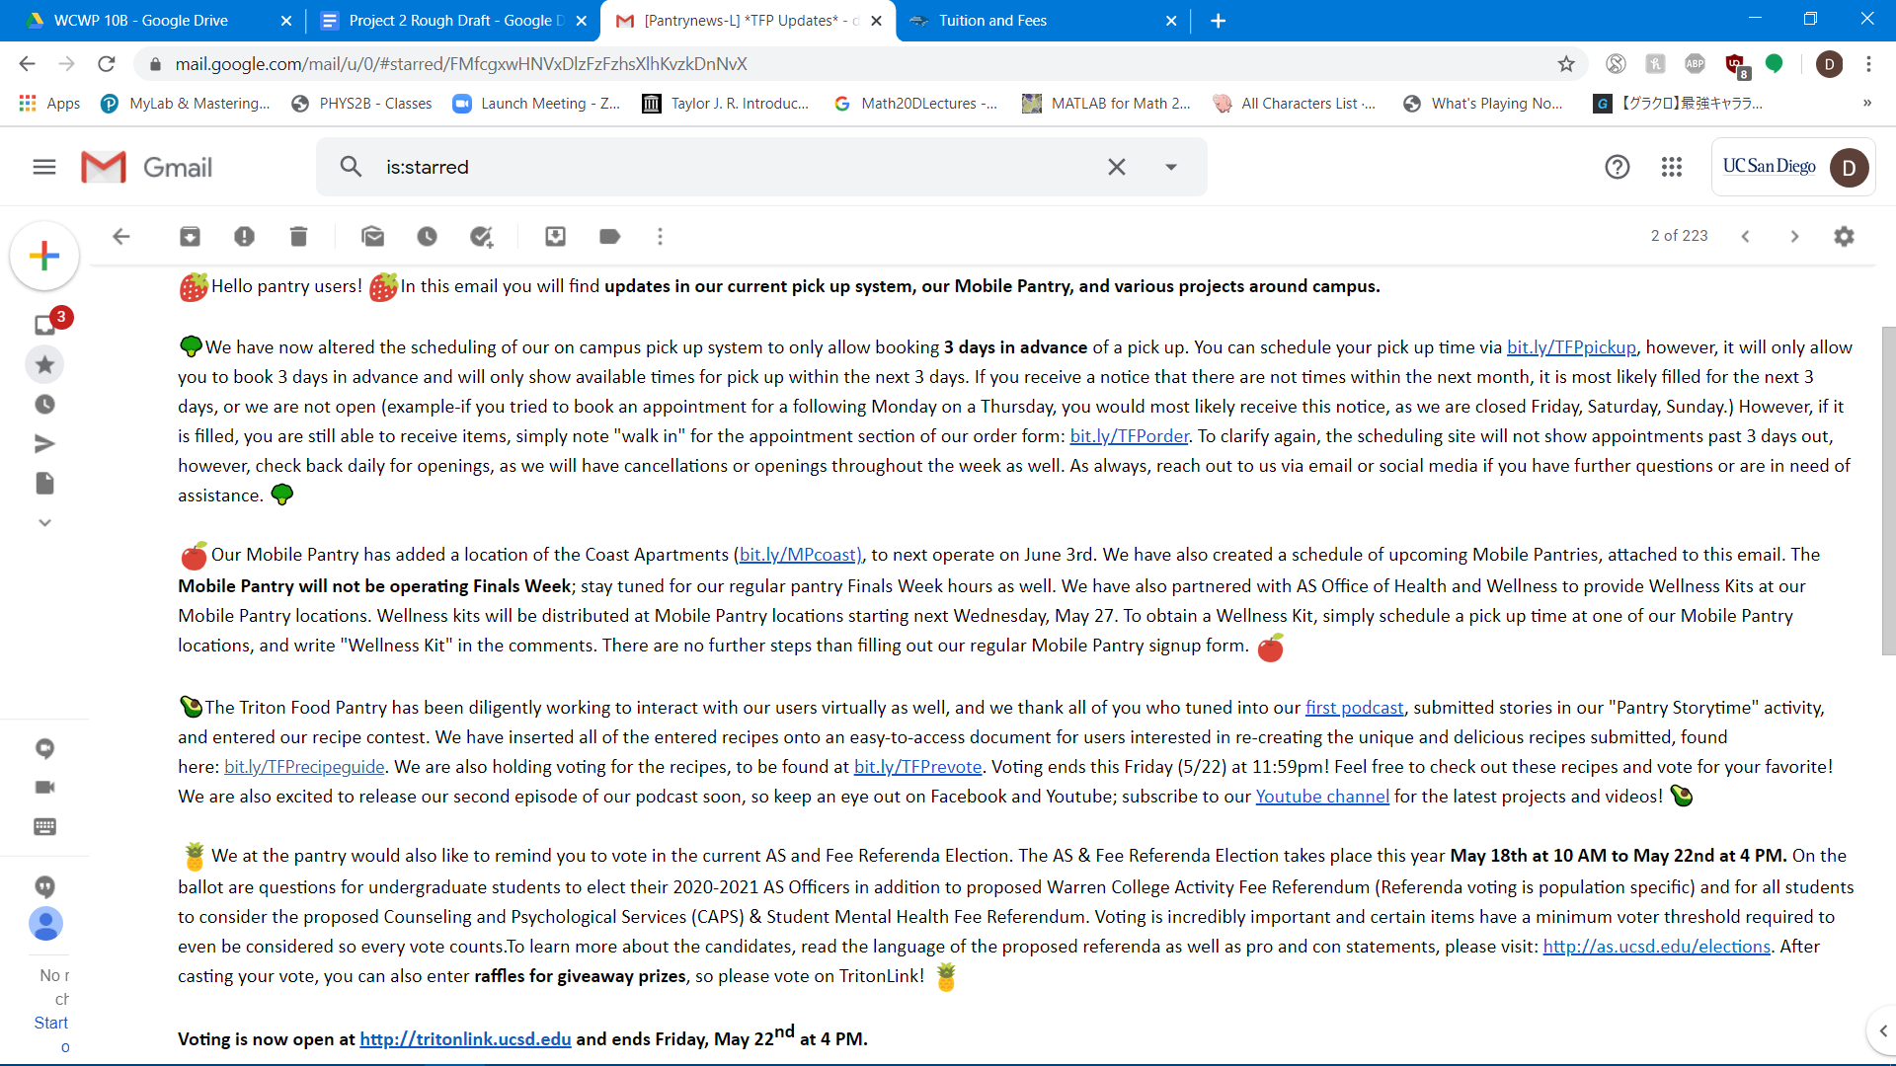
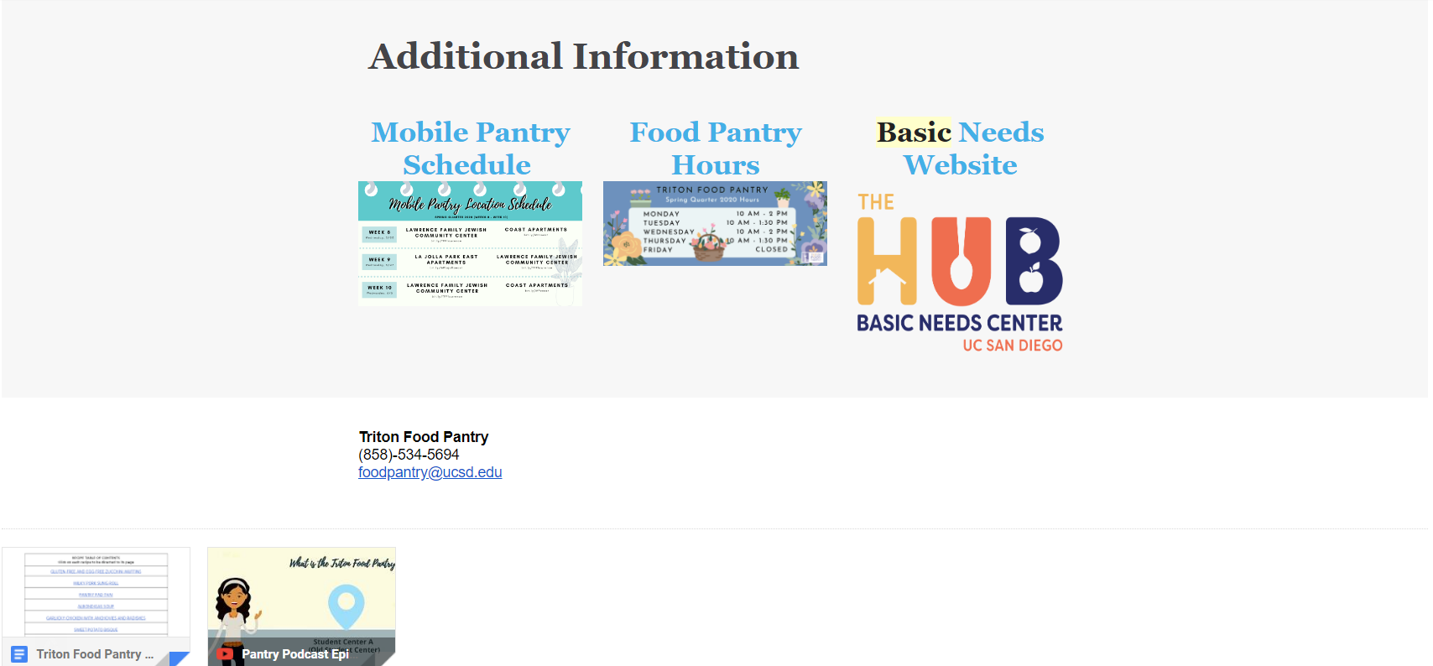
A New Email Format:
Spreading Awareness of Basic Needs Resources on the UC San Diego Campus
Daniel Maldonado Naranjo
Old Format
New Format
Conclusion
Background
The solution
The University of California (UC) Global Food Initiative began in 2014, what originally began as an effort between the ten UC campuses has grown to involve both UC Agriculture and Natural Resources and Lawrence Berkeley National Laboratory. The initiative's goal is to find a method of sustainably and nutritiously feeding the world’s growing population by 2025 (Global Food Initiative). Despite its efforts: establishing basic needs hubs, food pantries, and providing workshops 42% of undergraduate students at UCs still experience food insecurity (Watson).
Add your information, graphs and images to this section.
My proposed solution addresses one of the main issues when trying to deal with food insecurity; providing concise, detailed and engaging information. Implementing the proposed solution will increase the awareness and use of the available campus resources for food insecurity. Furthermore, campus engagement and interaction between students and the administration will improve. Ultimately this will help create an environment where students feel safe and encouraged to seek out help, where their efforts will be reciprocated by the university.
The Problem
Future Goals
There are a lot of resources available to students, however people are unaware and uncomfortable using them due to a lack of an accepting atmosphere. At schools like the UCs there is always a competitive atmosphere to everything making people want to hide any perceived weaknesses or shortcomings they may have. One undergraduate states “Food insecurity isn’t something that is very obvious because . . . you can’t always tell who’s food insecure” (Watson). It is no surprise that institutions try to hide the fact that some of their students may be going through food insecurity in order to protect their own reputation. To make matters worse, the information provided by UCSD often comes in lengthy blocks of text that are unpleasant to the eye and reduce reader engagement. When information about the food pantry or basic needs resource center is sent out, it is usually lost in the influx of daily emails about construction notices, campus events, and canvas announcements among other things. It is details like these that discourages people who face food insecurity from seeking assistance since there is limited effort made by the university to directly engage with them.
A possible drawback could be that some students may not open the revamped emails sent by UCSD if they have previously opened the text heavy emails and they are assuming that the formatting will be the same. This would mean that these students would miss out on the new information being sent out through email. Although some students may not access the revamped emails initially, an increase social media campaign and strategic distribution of flyers can lead students back to the emails and their newly upgraded formatting, where students can access more detailed information.
Project Goals
Noticeable Adjustments
I propose that UCSD revamp its current text heavy format for something more viewer friendly so the information put out can be engaging for students.
- create a relationship between the administration and students
- foster an environment where students feel safe and seek help
- provide concise, detailed and engaging information.
- spread awareness about food insecurity and available resources
Concise formatting of the emails
Removed irrelevant information and images
Buttons to replace the massive amount of links
Email communications and website are in sync based on information and presentation will present students with a user friendly experience that is engaging.
Literature Cited
Mock, Brentin, and CityLab. “When People Resist City Tree-Planting, It's Not From a Lack of
Awareness.” CityLab, Bloomberg, 11 Jan. 2019, www.citylab.com/environment/2019/01/detroit-tree-planting-programs-white-environmentalism-research/579937/.
University of California Office of the President. Global Food Initiative: Food and Housing
Security at the University of California. Berkeley: U of California Press, 2017.
Watson, Tyler D., et al. “College Students Identify University Support for Basic Needs and Life
Skills as Key Ingredient in Addressing Food Insecurity on Campus.” California Agriculture, vol. 71, no. 3, 2017, pp. 130–138., doi:10.3733/ca.2017a0023.

